Slide 1
Recursion and It’s Type

Slide 2
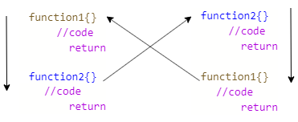
Types of Recursion
Direct Recursion:
A function is called direct recursive if it call itself again
Indirect Recursion
In indirect recursion, a function calls another function which then calls the first function again.

Slide 3
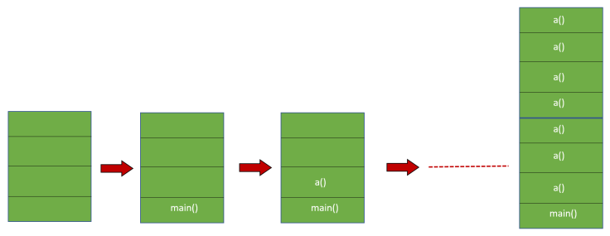
Stack Overflow
occurs when a computer program tries to use more memory space in the call stack than has been allocated to that stack.

Slide 4
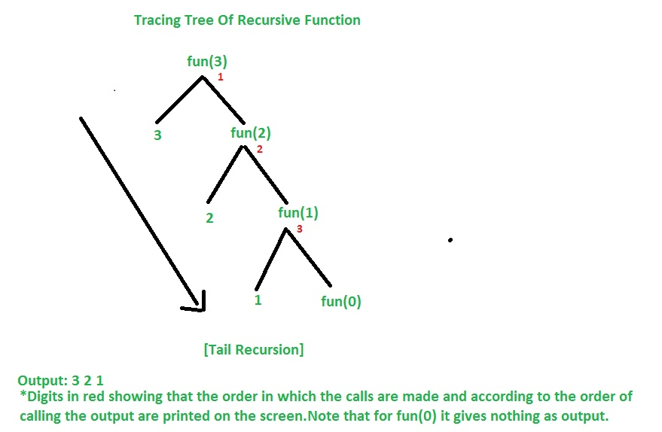
Tail Recursion:
Tail recursion is defined as a recursive function in which the recursive call is the last statement that is executed by the function.

Slide 5
Non Tail Recursion:

